Slide 1


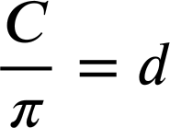
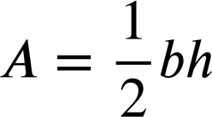
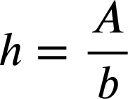
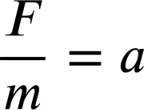




Changing the subject with simple formula
Task A: Identifying the subject of the formula
1) Identify the subject in each of these formula/equations.
a)
b)
c)
d)
e)
f)
g)
h)
2) Aisha is solving the equation 85 − 3x = 17
The equation can be rearranged in these forms:
85 − 3x = 17
85 − 17 = 3x
85 = 17 + 3x
85 = 3x + 17
The form 85 − 17 = 3x is the best rearrangement because 3x is the subject.

Slide 2
Changing the subject with simple formula
Task B: Changing the subject of simple formula
1) In each equation/formula change the subject as instructed.
a) Make x the subject.
b) Make l the subject.
x − 2.7 = 8.1
P = 3l
c) Make y the subject.
d) Make w the subject.
17 − y = 4
A = l × w
e) Make u the subject.
f) Make r the subject.
v = u + at
C = 2πr
2) Rearrange this formula as instructed.
F − E + V = 2
a) Make F the subject.
b) Make V the subject.
c) Make E the subject.
Mathematics in Education and Industry
v2.3

